Slide 1

Filtrado de Datos
Licenciatura en Física
Estadística para ciencias físicas
Erick Castro
Francisco Bustamante
Daniel Cerda
Notes:
Be specific and direct in the title. Use the subtitle to give the specific context of the speech.
-The goal should be to capture the audience’s attention which can be done with a quote, a startling statistic, or fact. It is not necessary to include this attention getter on the slide.

Slide 2

Contenidos
[Use this space to place an image that best captures the main idea of the speech]
Introducción
- Transformada de Fourier
- ¿Qué es el filtrado de datos?
- Filtro paso bajo
- Filtro de Wiener
- Filtro paso alto
- Filtro de componentes-mínimos
- Bibliografía
Notes:
Use the background points to post details that are not common knowledge, or that the audience will need to understand the context of the speech.
-Do not read these main points from the PowerPoint, instead elaborate on these points during the speech.

Slide 3
INTRODUCCIÓN
Notes:
Dedicate this entire slide to the thesis statement. It is the reason the speech is being given. Use this time to reveal the three main points of the speech (slides 4,5,6) as an overview for the direction of the speech:
-[type main point #1 here]
-[type main point #2 here]
-[type main point #3 here]
Be sure to transition to the first main point and the next slide.

Slide 4
Transformada de Fourier
Transforma los datos hacia el plano de coeficientes de fourier.
Y con dichos coeficientes puede atenuar el ruido, limpando la señal.
Notes:
The counterargument should be the most common argument against the topic. The goal for this slide is to address the counterargument in such a way as to actually strengthen the original topic. Be sure to address each piece of evidence against the topic. As you address each piece of evidence elaborate on the text found on the slide. Remember to transition to the final slide, the action step.

Slide 5
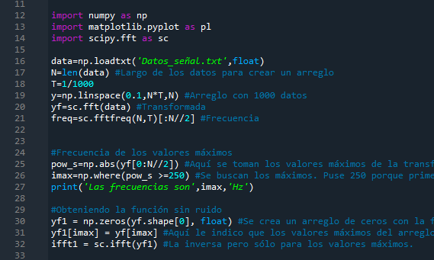
Ejemplo: Transformada de fourier aplicada a una señal
Notes:
The counterargument should be the most common argument against the topic. The goal for this slide is to address the counterargument in such a way as to actually strengthen the original topic. Be sure to address each piece of evidence against the topic. As you address each piece of evidence elaborate on the text found on the slide. Remember to transition to the final slide, the action step.

Slide 6
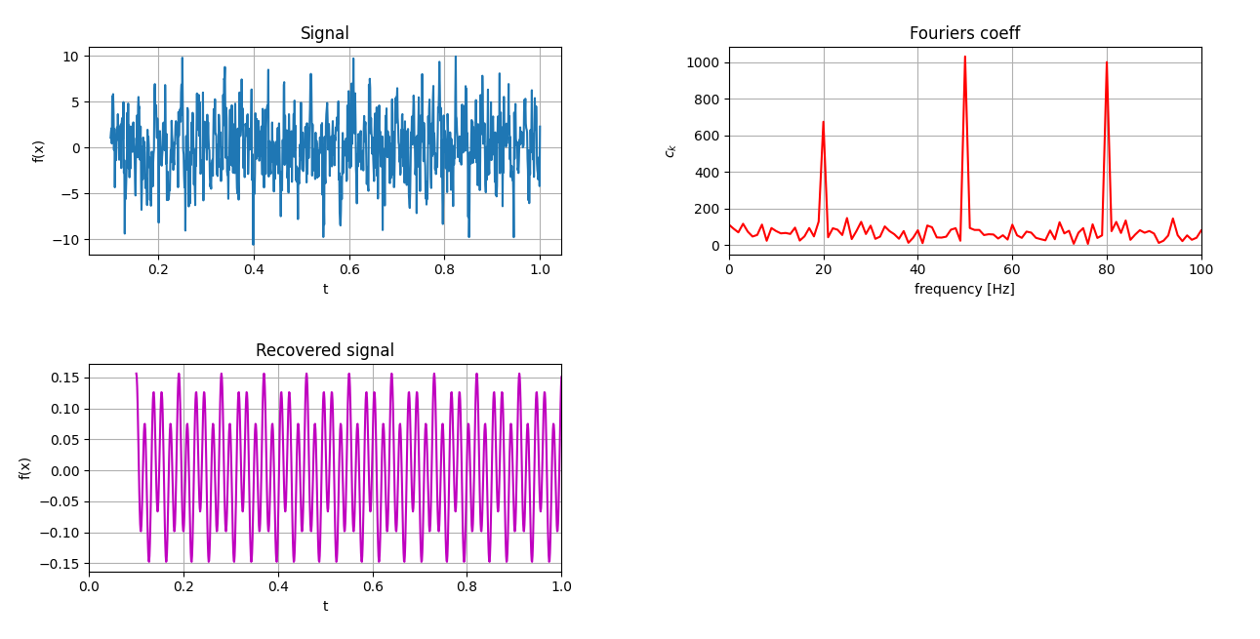
Ejemplo: Transformada de fourier aplicada a una señal
Notes:
The counterargument should be the most common argument against the topic. The goal for this slide is to address the counterargument in such a way as to actually strengthen the original topic. Be sure to address each piece of evidence against the topic. As you address each piece of evidence elaborate on the text found on the slide. Remember to transition to the final slide, the action step.

Slide 7
¿QUÉ ES EL FILTRADO DE DATOS?
Notes:
Dedicate this entire slide to the thesis statement. It is the reason the speech is being given. Use this time to reveal the three main points of the speech (slides 4,5,6) as an overview for the direction of the speech:
-[type main point #1 here]
-[type main point #2 here]
-[type main point #3 here]
Be sure to transition to the first main point and the next slide.

Slide 8
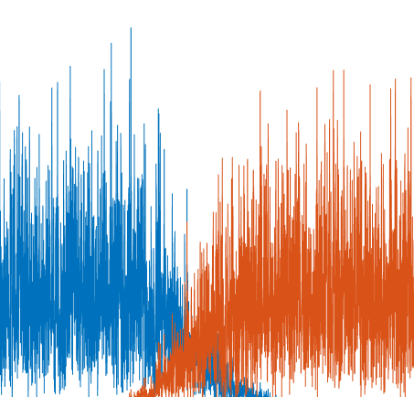
¿Qué es el filtrado de datos?
Extrae y recobra información desde datos con ruido.
Reduce dicho ruido y comprime la señal.
Permite identificar datos atípicos.
Y analizarlos de manera más rápida y eficiente.
[use this space to place an image that best captures the main idea of point #1]
Notes:
The title of main point #1 should be clear and concise. Each piece of evidence should be summarized for clarity and cited correctly. Do not simply read the pieces of evidence, but elaborate where needed.
[type notes for elaboration here]
Be sure to transition to main point #2 and the next slide.

Slide 9
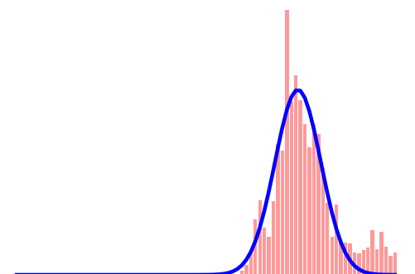
¿Qué es el filtrado de datos?
Trabaja utilizando recursos tales como:
i) Transformadas de Fourier.
ii) Ajuste de modelos (ej Gaussianos.)
Todo algoritmo y ajuste utilizado require estimaciones iniciales.
Muchos instrumentos filtrarán datos, siendo un efecto inevitable.
[use this space to place an image that best captures the main idea of point #2]
Notes:
The title of main point #2 should be clear and concise. Each piece of evidence should be summarized for clarity and cited correctly. Do not simply read the pieces of evidence, but elaborate where needed.
[type notes for elaboration here]
Be sure to transition to main point #3 and the next slide.

Slide 10
FILTRO PASO BAJO
Notes:
Dedicate this entire slide to the thesis statement. It is the reason the speech is being given. Use this time to reveal the three main points of the speech (slides 4,5,6) as an overview for the direction of the speech:
-[type main point #1 here]
-[type main point #2 here]
-[type main point #3 here]
Be sure to transition to the first main point and the next slide.

Slide 11
Filtro Paso Bajo
El ruido suele ser “blanco” y se extiende por todo el espectro.
Si la señal domina en frecuencias bajas, podemos reducir las frecuencias altas, eliminando gran parte del ruido.
Notes:
The counterargument should be the most common argument against the topic. The goal for this slide is to address the counterargument in such a way as to actually strengthen the original topic. Be sure to address each piece of evidence against the topic. As you address each piece of evidence elaborate on the text found on the slide. Remember to transition to the final slide, the action step.

Slide 12
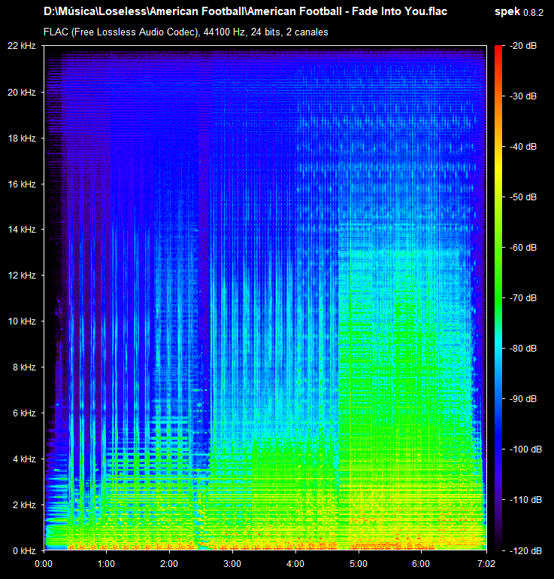
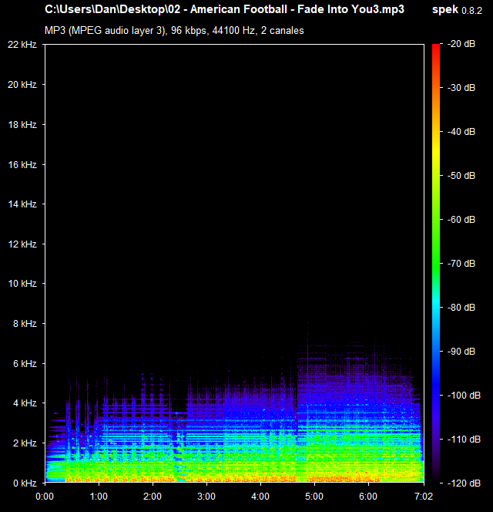
Ejemplo: Filtro paso bajo aplicado a una canción
Notes:
The counterargument should be the most common argument against the topic. The goal for this slide is to address the counterargument in such a way as to actually strengthen the original topic. Be sure to address each piece of evidence against the topic. As you address each piece of evidence elaborate on the text found on the slide. Remember to transition to the final slide, the action step.

Slide 13

Filtro de Wiener
Produce un estimado de la señal deseada.
Opera sobre la transformada de Fourier.
Modela los componentes a una gaussiana.
Reduce el error cuadrático medio.
S : Espectro de la señal
N : Espectro del ruido
Notes:
The title of main point #1 should be clear and concise. Each piece of evidence should be summarized for clarity and cited correctly. Do not simply read the pieces of evidence, but elaborate where needed.
[type notes for elaboration here]
Be sure to transition to main point #2 and the next slide.

Slide 14
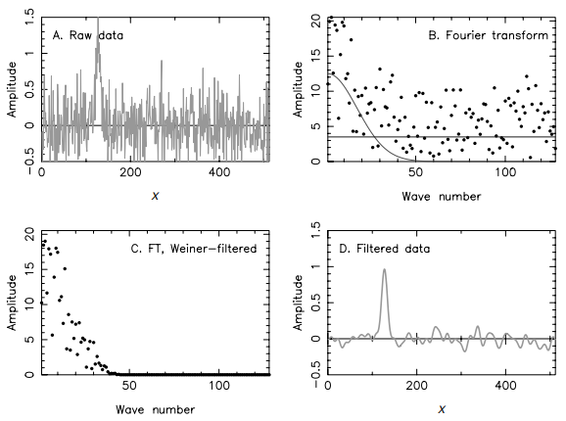
Ejemplo: Filtro Wiener aplicado a una señal con ruido Gaussiano aleatorio
Filtro calibrado con ruido gaussiano aleatorio.
DFT del ruido y la señal modelado a una curva gaussiana centrada en cero y una línea horizontal.
DFT con filtro Wiener aplicado en el dominio de las frecuencias.
Señal mejorada gracias al filtro aplicado, obtenida con una DFT inversa.
Notes:
The counterargument should be the most common argument against the topic. The goal for this slide is to address the counterargument in such a way as to actually strengthen the original topic. Be sure to address each piece of evidence against the topic. As you address each piece of evidence elaborate on the text found on the slide. Remember to transition to the final slide, the action step.

Slide 15
FILTRO PASO ALTO
Notes:
Dedicate this entire slide to the thesis statement. It is the reason the speech is being given. Use this time to reveal the three main points of the speech (slides 4,5,6) as an overview for the direction of the speech:
-[type main point #1 here]
-[type main point #2 here]
-[type main point #3 here]
Be sure to transition to the first main point and the next slide.

Slide 16
Filtro Paso Alto
El ruido se intercala con la señal y resulta complicado separar uno de otro.
Si la señal domina en frecuencias bajas, debemos ser más astutos para reducir el ruido presente en frecuencias bajas.
Ya que las técnicas usadas en el filtro paso bajo podrían no ser efectivas o llevar a errores.
Notes:
The counterargument should be the most common argument against the topic. The goal for this slide is to address the counterargument in such a way as to actually strengthen the original topic. Be sure to address each piece of evidence against the topic. As you address each piece of evidence elaborate on the text found on the slide. Remember to transition to the final slide, the action step.

Slide 17
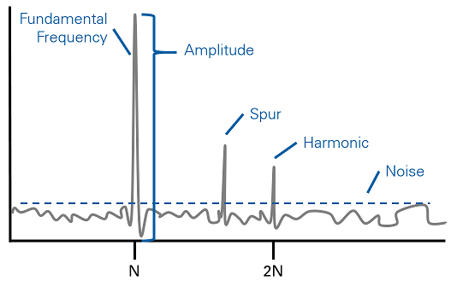
Filtro Paso Alto
Las frecuencias bajas poseen harmónicos.
Si aplicamos un filtro paso alto seguiremos teniendo “ruido” en frecuencias agudas.
Por lo tanto debemos eliminar dicho ruido antes de aplicar el filtro.
A este proceso se le denomina filtro de componentes-mínimos.
[use this space to place an image that best captures the main idea of point #2]
Notes:
The title of main point #2 should be clear and concise. Each piece of evidence should be summarized for clarity and cited correctly. Do not simply read the pieces of evidence, but elaborate where needed.
[type notes for elaboration here]
Be sure to transition to main point #3 and the next slide.

Slide 18
Filtro de componentes-mínimos
(i) Crea una “baseline” parchando regiones donde la señal sea evidente.
(ii) Quita desde la baseline una primera aproximación a la señal parchada.
(iii) Aplica transformada de fourier al “baseline” resultante.
(iv) Remueve las frecuencias agudas en el plano fourier para separar las amplitudes de las frecuencias agudas.
(v) Aplica una transformada inversa usando estos componentes mínimos.
(vi) Añadir la primera aproximación del paso (ii) a la baseline.
Notes:
The counterargument should be the most common argument against the topic. The goal for this slide is to address the counterargument in such a way as to actually strengthen the original topic. Be sure to address each piece of evidence against the topic. As you address each piece of evidence elaborate on the text found on the slide. Remember to transition to the final slide, the action step.

Slide 19
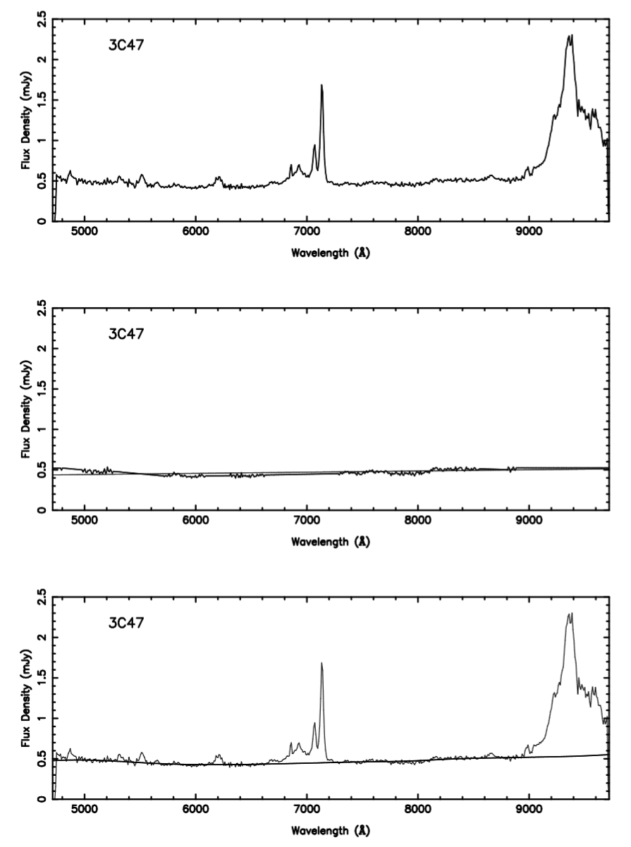
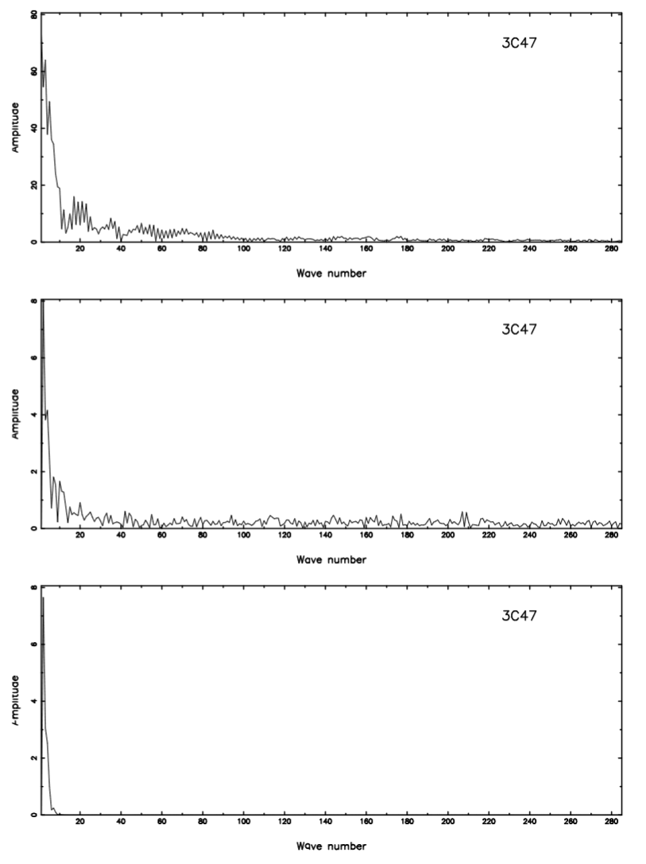
Ejemplo: Filtro de componentes-mínimos
Notes:
The counterargument should be the most common argument against the topic. The goal for this slide is to address the counterargument in such a way as to actually strengthen the original topic. Be sure to address each piece of evidence against the topic. As you address each piece of evidence elaborate on the text found on the slide. Remember to transition to the final slide, the action step.

Slide 20
Bibliografía
Wall, J. V., & Jenkins, C. R. (2012). Practical statistics for astronomers. Cambridge University Press.
Wall, J. V. (1997). Minimum-component baselines: Fourier analysis for continuum assessment. Astronomy & Astrophisics Supplement Series.
Notes:
The counterargument should be the most common argument against the topic. The goal for this slide is to address the counterargument in such a way as to actually strengthen the original topic. Be sure to address each piece of evidence against the topic. As you address each piece of evidence elaborate on the text found on the slide. Remember to transition to the final slide, the action step.

